Slide 1
Lecture 7 Solving Linear Systems and Scientific Computing Libraries
Prof. Brendan Kochunas
9/25/2019
NERS 590-004

Slide 2
Outline
Short Recap of Last Lecture
Classical Iterative Methods
Multigrid Methods
Krylov Methods
Scientific Computing Libraries

Slide 3
Learning Objectives
Understand the differences of various approaches to solving linear systems
Understand how to determine what method might be best for your application
Become aware of popular, high quality scientific computing libraries

Slide 4
Basic Linear Algebra Operations
Inner/Dot Product
(vector-vector multiply)
Residual and Norms of Vectors
residual
1-norm
Matrix-vector Multiply
2-norm (“average error”)
∞-norm (“max local error”)
Matrix-Matrix Multiply
p-norm

Slide 5
LU and QR Decompositions
QR Decomposition
LU Decomposition
Useful for obtaining orthonormal basis
Useful for solving linear systems
Obtaining by Gram-Schmidt
project
Forward elimination
orthogonalize
normalize
Backward Substitution

Slide 6
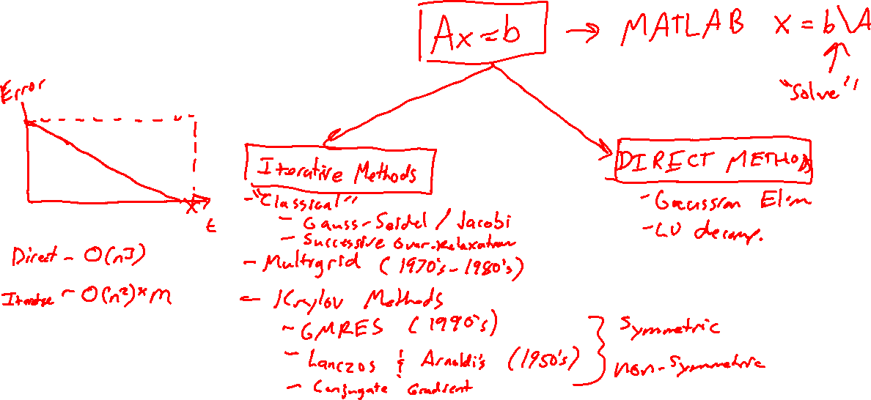
Solving Linear Systems

Slide 7
Classical Iterative Methods

Slide 8
Classical Iteration Schemes
U
L
D
Jacobi
Gauss-Siedel

Slide 9
Do they converge?
Fixed point iteration
Express iterate as combination of exact solution and error
If the method converges then:

Slide 10
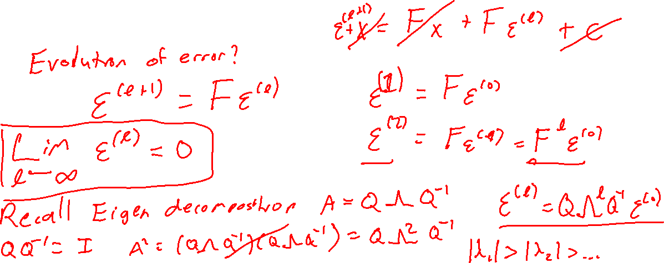
Condition for Convergence

Slide 11
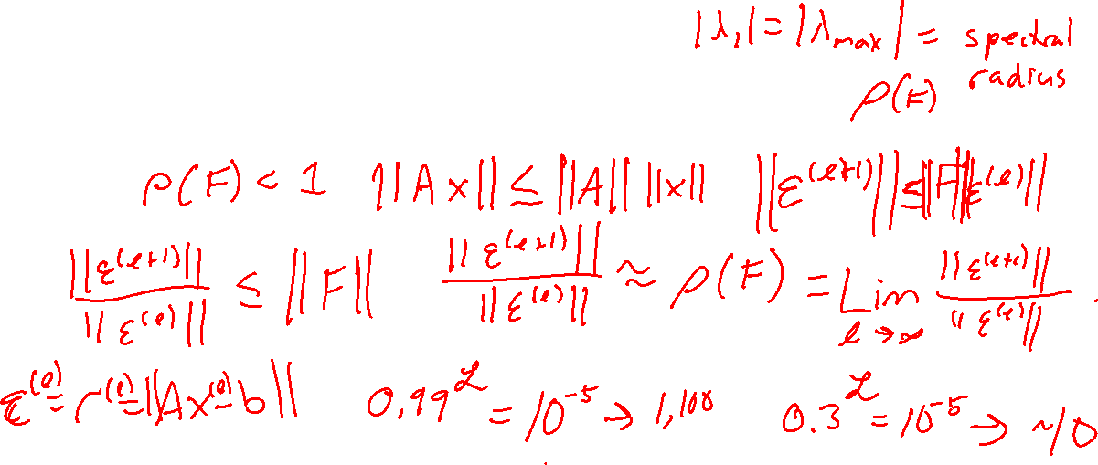
More about the spectral radius
The spectral radius determines the rate of convergence (for fixed point iteration schemes)

Slide 12
Summary of Classical Iteration Schemes
Implementations are very simple
Error properties are very well understood
Generally slowly converging in practical problems
Good for simple problems

Slide 13
Multigrid Methods

Slide 14
Multigrid Methods
Low Frequency
Logical extension to classical methods that arises from error analysis.
Consider “shape” of error → frequency transform
Classical methods
very good at “smoothing”
high-frequency errors
Real Problem (multiple modes)
Images from: Briggs, Henson, and McCormick et al., A Multigrid Tutorial, 2nd Ed., SIAM Press (2000).

Slide 15
Multigrid Methods (2)
Central idea of multigrid is to “map” errors onto coarser grids
A low-frequency error on a fine-grid is a high-frequency error on a coarse-grid!
Recipe for Multigrid includes
How to map error from fine-grid to coarse-grid?
restriction operator (e.g. bi-linear average)
How to smooth error on each grid?
classical iteration scheme
How to correct error in fine-grid from coarse grid?
interpolation operator (e.g. linear interpolate)
How to traverse grids?
Images from: Briggs, Henson, and McCormick et al., A Multigrid Tutorial, 2nd Ed., SIAM Press (2000).

Slide 16
Multigrid: Restriction and Interpolation
Restriction
Interpolation
Images from: Briggs, Henson, and McCormick et al., A Multigrid Tutorial, 2nd Ed., SIAM Press (2000).

Slide 17
Multigrid: Traversing the Grids
W-cycle
V-cycle
Restrict
Interpolate
Full Multigrid
Smoother
Images from: Briggs, Henson, and McCormick et al., A Multigrid Tutorial, 2nd Ed., SIAM Press (2000).

Slide 18
Summary of Multigrid
Very good for elliptic problems
A type of fixed point iteration
May be analyzed via Fourier/Von Neumann Analysis for asymptotic convergence
Builds on traditional classical fixed point iterative techniques
Uses same elements and adds a few more (interpolation/prolongation)
Lots of parameters in the iteration that can be “tuned”
Good for structured grids and finite differenced or finite volume disc (e.g. discretized operator is a stencil)
Can be generalized to algebraic multi-grid (AMG)

Slide 19
Krylov Methods
Reference: Yousef Saad, Iterative Methods for Sparse Linear Systems, SIAM

Slide 20
Krylov (subspace) Methods
Use Krylov subspaces
Krylov subspaces are easy and efficient to construct
Use only matrix-vector operations (this is good for large sparse systems!)
Krylov methods also rely on projection
Specifically projection to the Krylov subspace

Slide 21
General Idea: Projection Methods
Two types: orthogonal and oblique
For a linear system:
A exists in R^{n} and K and L are two subspaces within R^{n}
An approximation of the solution is:
which has the residual:
Solution by orthogonal projection means

Slide 22
Orthogonalization Schemes: Arnoldi and GMRES
Arnoldi
GMRES
Uses Gram-Schmidt procedure to build an orthonormal basis
Generalized Minimum Residual
Notes:
v_i are column vectors of Vm and h_i,j are elements of H

Slide 23
Special cases: Symmetric Matrices
Lanczos algorithm for symmetric matrices
Conjugate Gradient (CG)
This is a simplification of Arnoldi’s method, where the Hessenberg matrix is tridiagonal
Only for symmetric systems

Slide 24
Bi-Orthognalization Schemes: Lanczos and BiCGSTAB
Lanczos (Generalize for non-symmetric)
BiCGSTAB
Build 2 subspaces
Variation of Conjugate Gradient Squared (Transpose free Bi-Conjugate Gradient)
Notes:
Steps 5 and 6 are the three-term recurrence

Slide 25
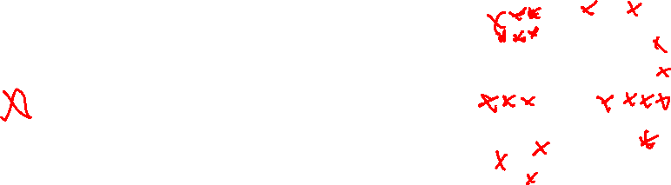
Convergence of Krylov Methods
Convergence is related to properties of the eigenspectrum of the coefficient matrix, A.
But more specifically the condition number:
Convergence is often not monotonic
GMRES does well if eigenvalues of A are clustered.
BiCGSTAB does well if eigenvalues are spread out
It isolates extremal eigenvalues
Im
Re
Notes:
https://www.youtube.com/watch?v=_i3oqC12QSA
https://github.com/carlos-echeverria/conv-diff
https://github.com/andrenarchy/krypy

Slide 26
More about condition numbers
Generally it tells us how much an output value can change relate to a small change in the input
Bounds accuracy of approximate solution to a linear system
Generally given by:
Recall that under certain conditions the SVD may be equivalent to the eigendecomposition so sometimes:
Note that this differs from the classical iterative techniques where generally convergence is given by:
The discretization of most PDE’s give condition numbers that are unbounded, and increase as the problem size increases.

Slide 27
Preconditioning
Objective: Lower the condition number of A to achieve faster convergence
Left Preconditioner:
Right Preconditioner:
Properties of a good preconditioner
Large decrease in condition number for a wide range of A
Efficient to construct and apply
Krylov methods generally only as good as their preconditioner.
This is conservation of misery.
Research into preconditioners still an active topic
Consequently, for some problems classical iteration schemes are still the best choice

Slide 28
Lots of Types of Preconditioners
Classical methods; Jacobi, SOR, SSOR
Decomposition:
Incomplete LU (ILU): do an LU factorization but don’t change sparsity
Very difficult to parallelize
Cholesky
Polynomials: Chebyshev, Least-Squares
Multigrid
“Physics-based”

Slide 29
Summary of Krylov Methods
Orthogonalization
Bi-Orthogonalization
Usually requires more storage
e.g. Hessenberg matrix and GMRES vectors
Restarted forms attempt to mitigate this
Guaranteed to converge
May require full orthogonalization
Avoid storage by doing twice the work (bi-orthogonalization)
Uses 3-term recurrence for orthogonalizing
Not guaranteed to converge, but it usually does
Probably need a preconditioner

Slide 30
Scientific Computing Libraries
BLAS, LAPACK, PETSc, Trilinos, and Others

Slide 31
BLAS (Basic Linear Algebra Subprograms)
BLAS is a (Fortran) programming interface to low-level linear algebra routines.
Examples of basic linear algebra operations:
Dot products, addition of vectors, scalar multiplication of vectors.
Matrix-vector multiplications.
Matrix-matrix multiplications.
Why BLAS?
Handwritten simple linear algebra routines can run at widely varying speeds.
Loop unrolling and finding correct compiler flags is key and sometimes becomes difficult
when using a new compiler or computer.
Basic linear algebra routines form the backbone of many sophisticated solvers and BLAS package tries to provide most optimized version of basic linear algebra routines.
Linking to BLAS, we get code that runs much faster than hand-written version of code.

Slide 32
BLAS (Basic Linear Algebra Subprograms)
BLAS-1 operations:
Routines which involve only vector operations: dot-products, vector norms.
S – Single Precision, D - Double Precision, C – Complex, Z – Double precision complex
_SWAP x <---> y S, D
_SCAL x <-- alpha * x S, D, C, Z, CS, ZD
_COPY x <-- y S, D, C, Z
_AXPY y <-- alpha * x + y S, D, C, Z
_DOT dot <-- S, D, DS
_DOTU dot <-- x^T*y C, Z
_DOTC dot <-- x^H*y C, Z
_NRM2 nrm2 <-- || x ||_2 S, D, SC, DZ
_ASUM nrm1 <-- || x ||_1 S, D, SC, DZ

Slide 33
BLAS (Basic Linear Algebra Subprograms)
BLAS-2 operations:
This level contains matrix-vector operations including, among other things, a generalized matrix-vector multiplication (gemv):
_GEMV y <-- alpha*A*x + beta*y, y <-- alpha*A^T*x + beta*y (General Real Matrix)
_GBMV y <-- alpha*A*x + beta*y, y <-- alpha*A^T*x + beta*y (General Banded)
_HEMV y <-- alpha*A*x + beta*y (Hermitian (complex))
_HBMV y <-- alpha*A*x + beta*y (Hermitian (banded))
_SYMV y <-- alpha*A*x + beta*y (Symmetric)
_SBMV y <-- alpha*A*x + beta*y (Symmetric banded)
_TRMV y <-- A*x , x <-- A^T*x (Triangular)
_TBMV y <-- A*x , x <-- A^T*x (Triangular banded)
_TRSV y <-- inv(A)*x , x <-- inv(A^T) * x

Slide 34
BLAS (Basic Linear Algebra Subprograms)
BLAS-3 Matrix-matrix operations:
This level operations are matrix-matrix multiplications.
_GEMM C <-- alpha op(A) op(B) + beta C
_SYMM C <-- alpha AB + beta C
_HEMM C <-- alpha AB + beta C
_SYRK C <-- alpha A A^T + beta C
_HERK C <-- alpha A A^H + beta C
_SYRK2 C <-- alpha A B^T + alpha B A^T + beta C
_TRMM B <-- alpha op(A) B
_TRSM B <-- alpha op(inv(A)) B

Slide 35
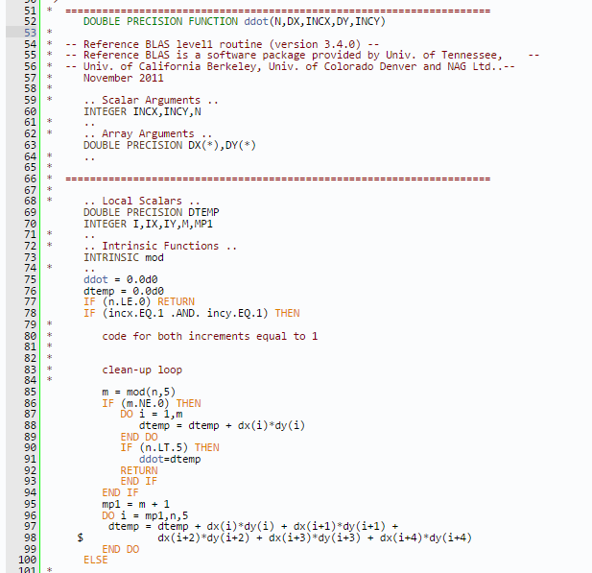
BLAS-Example Code
http://www.netlib.org/lapack/explore-html/

Slide 36
LAPACK
LA Pack is a collection of Fortran functions that can help you solve Linear Algebra related problems based on BLAS routines.
LAPACK provides routines for solving systems of simultaneous linear equations, least-squares solutions of linear systems of equations, eigenvalue problems, and singular value problems.
The associated matrix factorizations (LU, Cholesky, QR, SVD, Schur, generalized Schur) are also provided,
Dense and banded matrices are handled, but not general sparse matrices. In all areas, similar functionality is provided for real and complex matrices, in both single and double precision.
Online Reference: http://www.netlib.org/lapack

Slide 37
LAPACK Routines
Simple driver routines: Simple driver routines solve a linear algebra problem
Eg: Finding eigenvalues of a matrix, solving a set of linear equations etc.,
Expert driver routines: Expert driver routines do the same things as simple driver routines, but will provide more options or information to the user.
Eg: SGESV is used to solve linear systems whereas the expert driver SGESVX not only solves the linear system but will also provide the estimate of the condition number of input matrix.
Computational routines: Routines are mainly for internal use by LA Pack itself and called by driver routines.
Eg: LU, QR and other factorizations or reduction of symmetric matrix to tridiagonal form.

Slide 38
LAPACK Naming conventions
Lapack functions are usually named in the form XYYZZZ
X = type of problem that the routine solves
S Single precision real
D Double precision real
C Single complex
Z Double precision complex
YY = matrix types
GE General
BD Bidiagonal
HE Hermitian
HB Hermitian Band
SB Symmetric Band
ZZZ = indicate the computation performed
Eg: SV = Solve, SVX = Solve Expert

Slide 39
PETSc
Portable Extensible Toolkit for Scientific computing:
Developing parallel, nontrivial PDE solvers that deliver high performance is still difficult and requires months (or even years) of concentrated effort. PETSc is a toolkit that can ease these difficulties and reduce the development time, but it is not a black-box PDE solver, nor a silver bullet. — Barry Smith
Philosophy: Everything has a plugin architecture
Vectors, Matrices, Partitioning algorithms
Preconditioners, Krylov accelerators
Nonlinear solvers, Time integrators
Spatial discretizations
Application user loads plugin at run, no source code in sight. PETSc tries to keep solvers independent of physics and discretization.

Slide 41
Basic PETSc object usage

Slide 42
PETSc Vectors
PETSc vectors are fundamental datatypes of PETSc which is used represent field solutions, right-hand sides etc. Each process locally owns a subvector of contiguous global data.
Creating PETSc vectors:
VecCreate(MPI_Comm, Vec *)
VecSetSizes(Vec, int n, int N)
VecSetTypes(Vec, VecType typename)
VecSetFromOptions(Vec)
Supports all vector space operations VecDot(), VecNorm(), VecScale()

Slide 43
PETSc Vectors
Inserting entries into PETSc vectors:
Each process sets or add values and begins communications to send values to correct process and complete the communication.
VecSetValues(Vec v, int n, int rows[], PetscScalar values[], mode)
VecAssemblyBegin(Vec v)
VecAssemblyEnd(Vec v)
PETSc allows you to access the local storage with VecGetArray() functions.

Slide 44
PETSc Matrices
PETSc handles both sparse and dense matrix formats in parallel.

Slide 45
Parallel sparse matrix in PETSc

Slide 46
Other useful features of PETSc
Iterative solvers:
Linear solvers in PETSc KSP: Conjugate Gradient, Bi Conjugate Gradient, GMRES, etc.
Lots of sophisticated Preconditioners like block Jacobi, SOR, Multigrid, field-split, etc.
Nonlinear solvers (SNES):
Newton type with line search and trust-region
Quasi Newton methods
Nonlinear conjugate gradients
User-defined methods.
Time Integration strategies

Slide 47
TRILINOS
The Trilinos Project is an effort to develop algorithms and enabling technologies within an object-oriented software framework for the solution of large-scale, complex multi-physics engineering and scientific problems. A unique design feature of Trilinos is its focus on packages.
More extensive than PETSc and more complex to use.
Trilinos tries to provide an environment for solving FEM problems and PETSc provides an environment for solving sparse linear algebra problems.

Slide 48

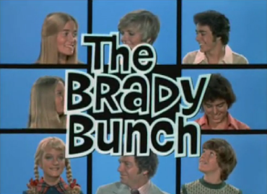
Capabilities
Trilinos – Greek for “String of Pearls”
Most package names are Greek
Duplication of capability
Some are deprecated
User Experience
Parallel Programming Environments
I/O Support
Mesh & Geometry
Framework & Tools
Discretization
Linear Algebra
Services
Linear & Eigen Solvers
Embedded Nonlinear Analysis
Software Engineering

Slide 49
https://trilinos.org/about/capabilities/

Slide 50

Contains Tools for:
Problem Discretization
Solution of Algebraic Systems
Uncertainty Quantification
Numerical Optimization
https://fastmath-scidac.llnl.gov/software-catalog.html

Slide 51
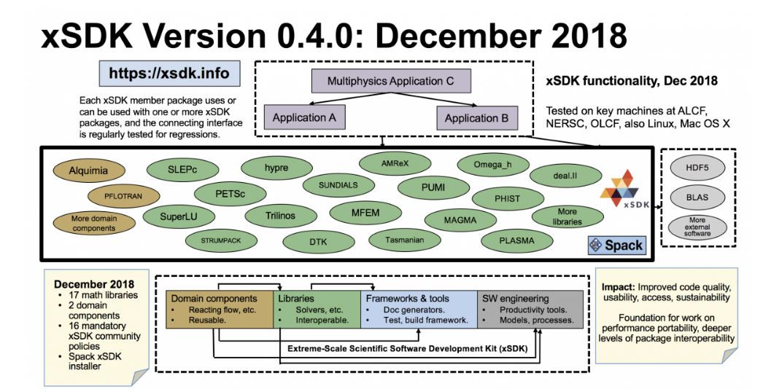
Integrating Libraries with your Code

